Slide 1
1.2: A History of User Experience Design
By: Minal Bombatkar

Slide 2
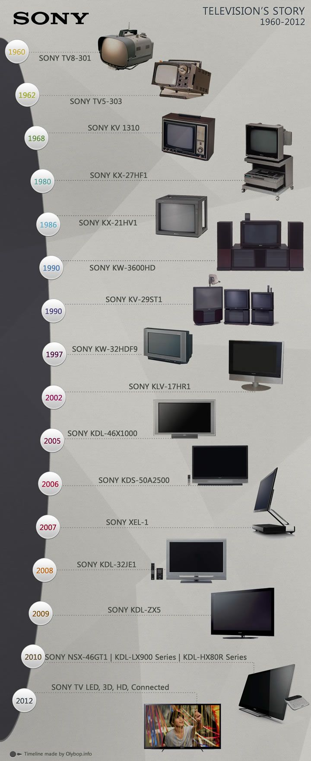
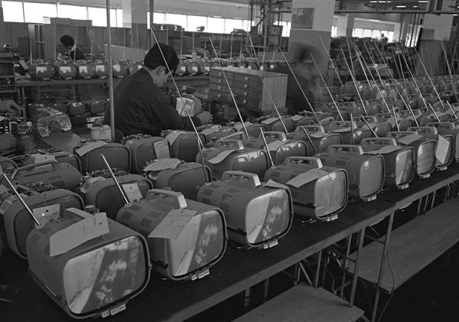
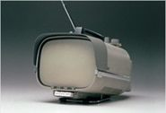
Product analysis and timeline for SONY Television
Background
Sony Corporation is a Japanese Multinational corporation, having many electronics devices such as Camera, Radio, Tap recorder, TV, many others products also it is in gaming, finance, and in entertainment industries.
May 1960: The TV8-301 portable transistor TV launched by Sony.
The TV8-301 was a small black and white. It had an eight-inch screen.
How does this change customer’s user experience and interaction with the brand?
Until, users are aware with radio system but television concept was totally new to the world.
It is notable for being the world's first all transistor television. It was priced high as it was innovative on multiple fronts. It was something of a luxury item and not a practical buy.
Image source: https://www.sony.net

Slide 3
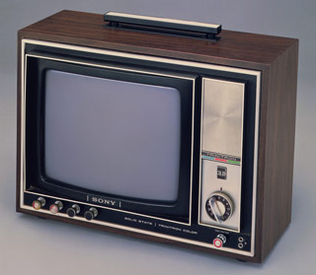
Product analysis and timeline for SONY Television
1975: The First Trinitron launched by Sony
The Trinitron series come with colour display and 12 to 13 inches screen come with picture tube.
How does this change customer’s user experience and interaction with the brand?
New innovation in the product gave users more options to experience the new technology. Television users experiencing more real feature after launching the colour TV by Sony brand. This series had good picture quality and sound quality was far superior. User noticed some cons was that colour fringing, visible tension wire, too sharp to be on edges, too soft to be a monitor. It had low price as compared the first launch television.
Image source: https://www.sony.net

Slide 4
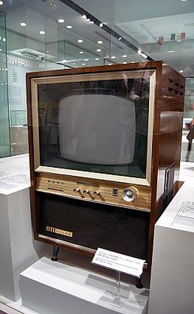
Product analysis and timeline for SONY Television
1996: KV-28SF5
The industry's first TV with a vertically and horizontally flat screen, made possible by the inclusion of the "Super Flat Trinitron" tube. Reproduced picture naturally and without distortion throughout the entire screen.
How does this change customer’s user experience and interaction with the brand?
With advance technology, Sony able to introduce the concept of flat screen in the industry. The Super Flat Trinitron feature allowed user to dramatically improve overall quality while reducing size. It’s vertically and horizontally flat screen design was not so popular but it stared the flat screen television era.
Image source: https://www.sony.net

Slide 5
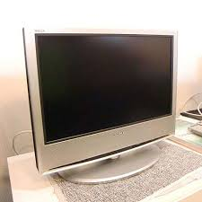
Product analysis and timeline for SONY Television
2000: XEL-1
The worlds first organic light emitting television was called the XEL-1. The XEL-1 was an 11 inch television, that offered a ground breaking new design and extreme slimness. The television featured Sony's OLED panel that allows the TV to have high contrast, high peak brightness, colour reproduction and rapid response time.
How does this change customer’s user experience and interaction with the brand?
Users ware surprised with this flat screen television. Up till now everyone aware with bulky size CR Tube television. It came in small size, light weight and portable to move. Customer ware happy to switch from Trinitron TV to flat screen television.
Image source: https://www.sony.net

Slide 6
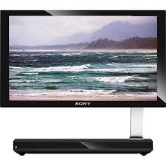
Product analysis and timeline for SONY Television
2005: KLV-17HR1
First-generation liquid crystal WEGA
In addition to its unique and innovative design, this model was based on WEGA signal processing technology, while retaining advanced picture quality.
How does this change customer’s user experience and interaction with the brand?
This televisions provide a bright picture, with high detail and natural colour display. Sony brand is now well known with pixel perfect picture quality. User
Image source: https://www.sony.net

Slide 7
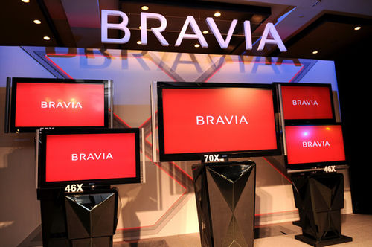
Product analysis and timeline for SONY Television
2010: BRAVIA
BRAVIA is a brand of Sony Visual Products. Its backronym is "Best Resolution Audio Visual Integrated Architecture". All Sony high-definition flat-panel LCD televisions in North America have carried the logo for BRAVIA since 2005. BRAVIA replaces the "LCD WEGA”
How does this change customer’s user experience and interaction with the brand?
With a special architecture of Bravia series the user experience with High Definition (HD) feature with great picture quality also improved sound functions.
Internet surfing was possible with this model. User don’t need to use computer for watching videos on You tube.
Image source: https://www.sony.net

Slide 8
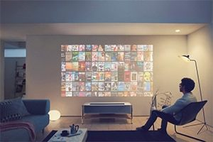
Product analysis and timeline for SONY Television
2017: The Game & Networks and Life Space UX
PlayStation is a virtual reality (VR) system that takes to the next level of immersion and enriches the gaming experience and New 4K Projector. Sony will display for the first time a concept model called "New 4K Projector "
How does this change customer’s user experience and interaction with the brand?
The Life Space UX concept is defined by delivering unique experiences and facilitating new ways to transform the living space. which proposes new encounters with various content such as books, films and music. Naturally, user can use it as a conventional projector, creating a big screen in your home by projecting images onto an adjacent wall, in order to view content. But the concept behind is all about the joy of discovering new content.
Image source: https://www.sony.net

Slide 9
References and image sources
https://www.sony.net/SonyInfo/CorporateInfo/History/sonyhistory-c.html
https://thebridge.jp/en/2013/03/sony-tvs-through-the-years-timeline
https://www.smartprix.com/bytes/sony-launches-4k-hdr-tv-lineup-in-india/
https://www.sony.net/SonyInfo/News/Press/
https://www.retrothing.com/2005/11/the_first_trini.html
https://en.wikipedia.org/wiki/List_of_Sony_BRAVIA_televisions
https://www.sony.net/SonyInfo/design/
Image resource
https://dribbble.com/shots/826764-Timeline-Sony
https://www.retrothing.com/2005/11/the_first_trini.html
https://www.sony.net/SonyInfo/CorporateInfo/History/sonyhistory.html

